Slide 1
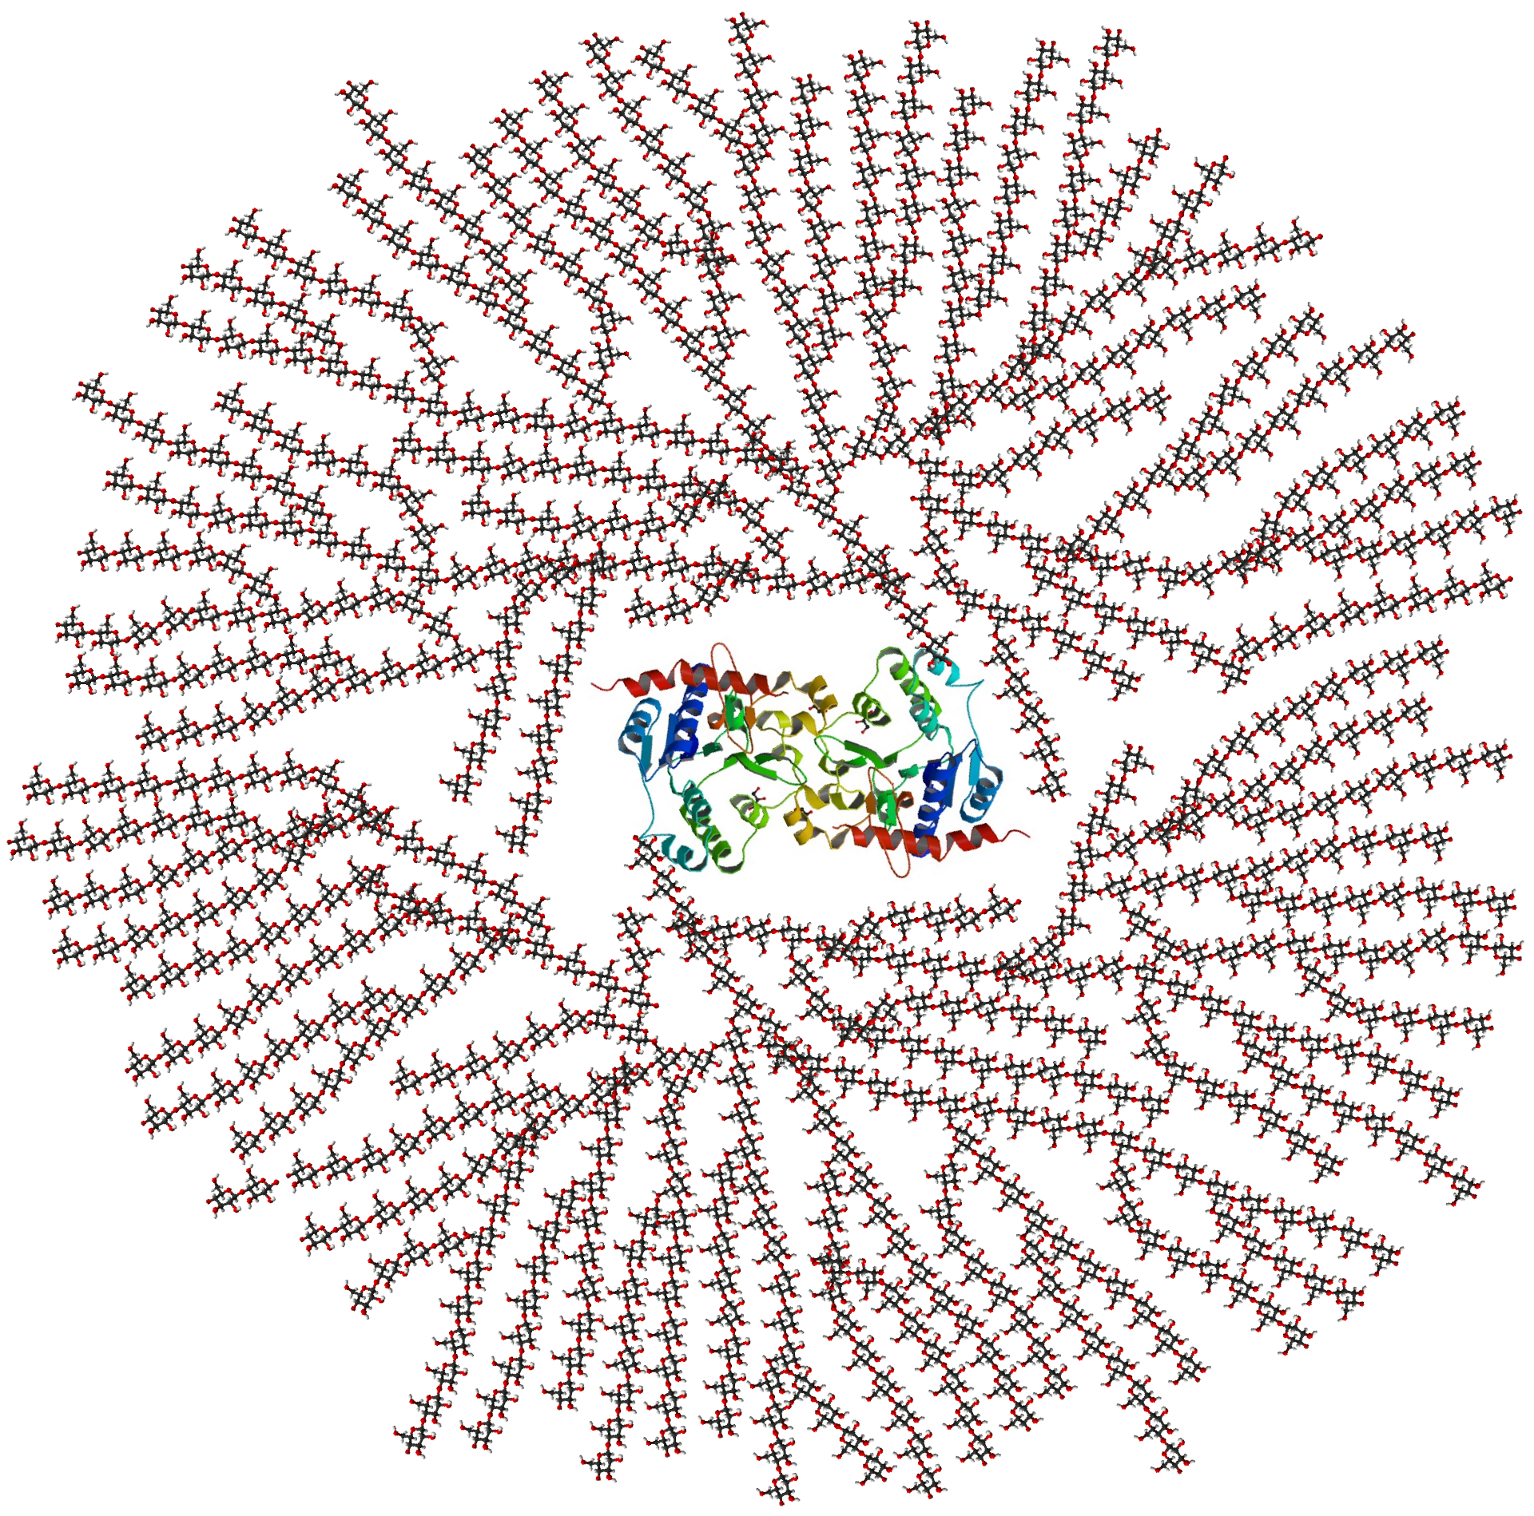
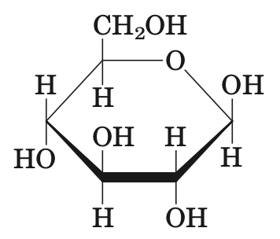
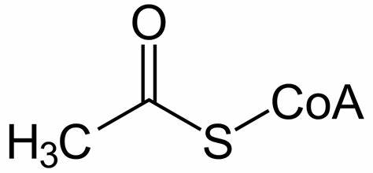

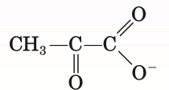
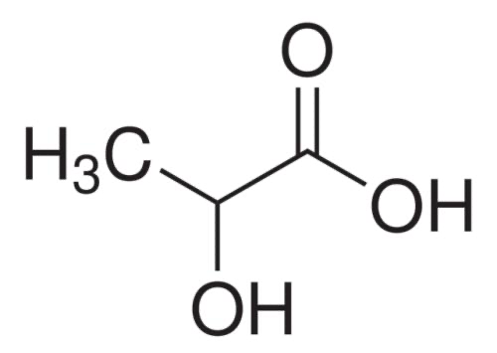
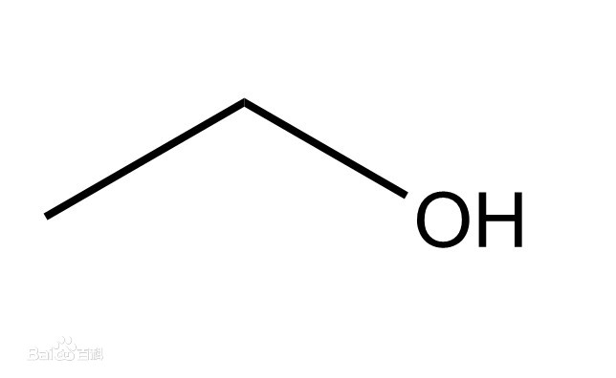
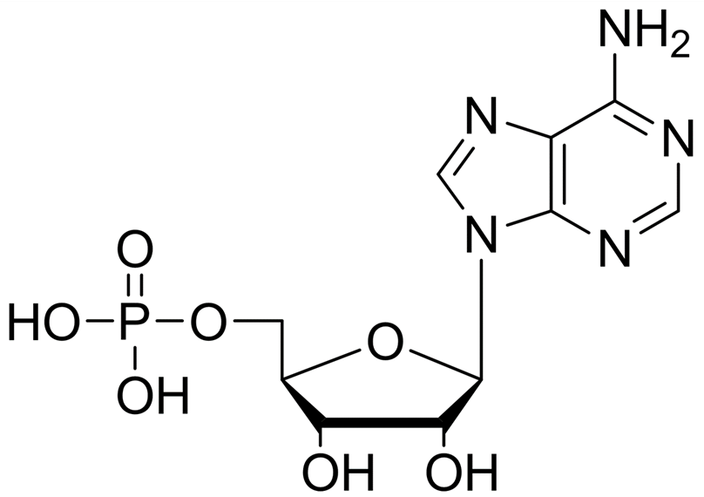
The degradation of carbohydrate
Oxidative decarboxylation of pyruvate
Glycogen
breakdown
Glycolysis
Acetyl-CoA
Pyruvate
Pyruvate
Glucose
Glycogen
Entry of some
other carbohydrates
CO2
oxaloacetate
CO2
Fermentation
citrate
the pentose phosphate
pathway
Citric acid cycle
ɑ-ketoglutarate
lactic acid
CO2
succinyl-CoA
ethyl + CO2
Ribose-5-phosphate
Biology Preparatory Course Class 9
Notes:
Oxidative~:p18
Glycolysis:p8
Entry~:p13
Glycogen breakdown:p2
The pentose~:p31
Fermentation:p28
Citric~:p17

Slide 2
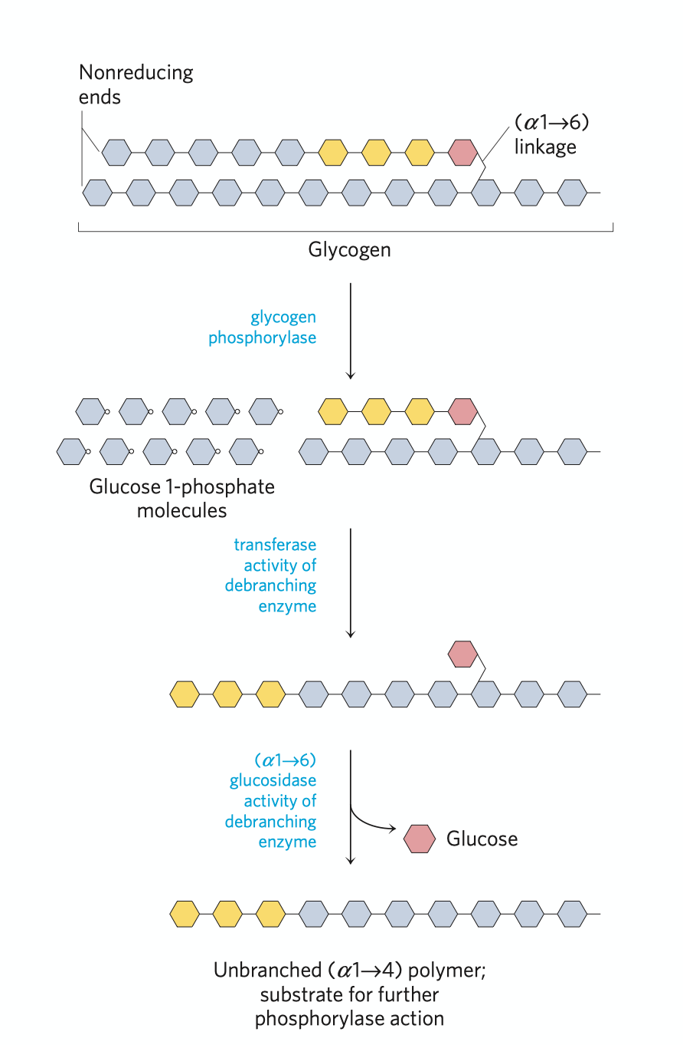
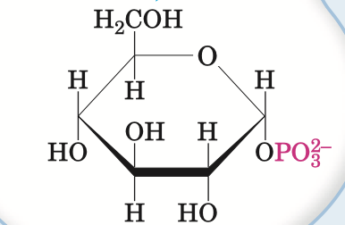
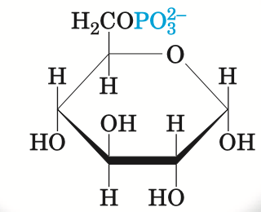
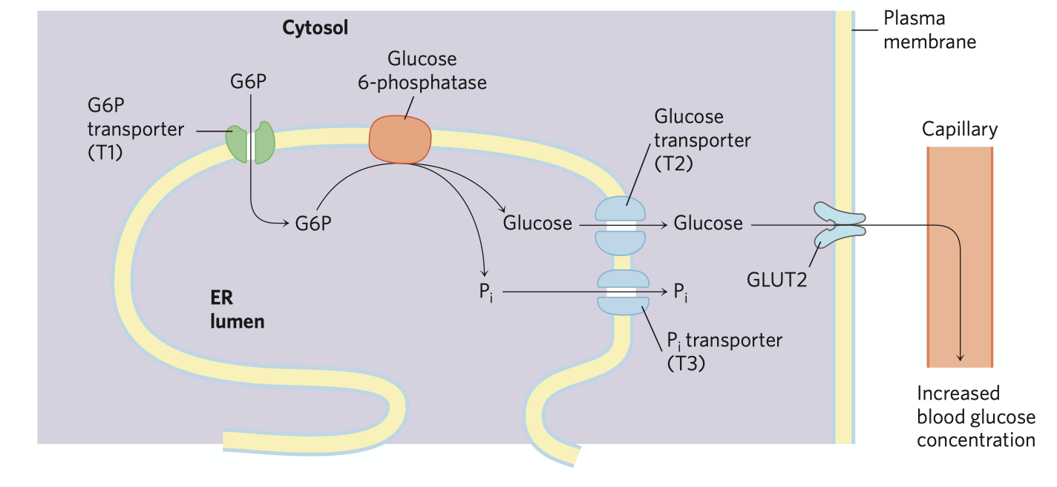

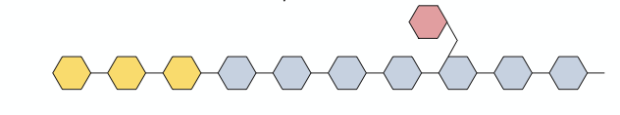
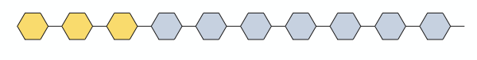
Glycogen breakdown
Glucose-1-phosphate
Glucose-6-phosphate
glycogen phosphorylase
phosphoglucomutase
(tranferase activity)
debranching enzyme
Glucose-6-phosphotase
(glucosidase activity)
debranching enzyme
Notes:
Glycogen phosphorylase:p3
Debranching enzyme:p5
Phosphoglucomutase:p6
Glucose-6-phosphatase:p7
Return:p1

Slide 3
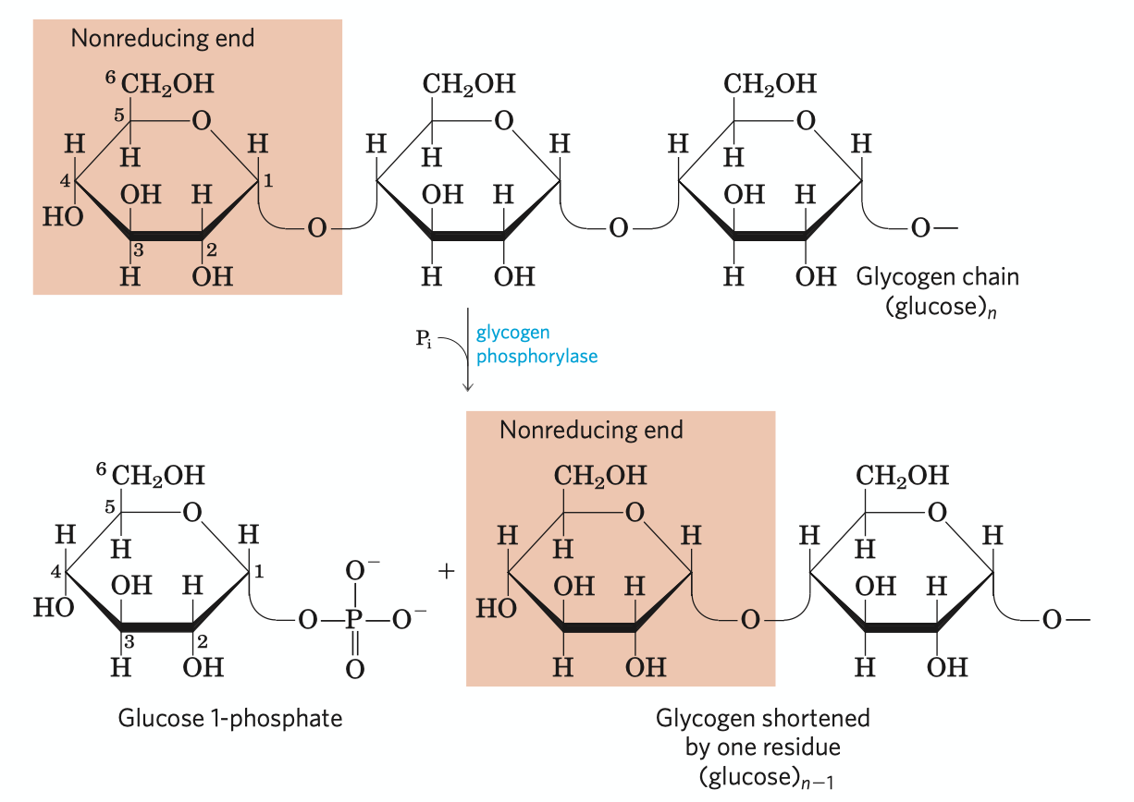
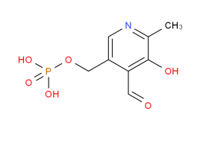
Removal of glucose residue: phosphorolysis
Glycogen phosphorylase catalyzes the reaction in which an ɑ1-4 between two glucose residues at a non-reducing end of glycogen undergoes attack by Pi, removing the terminal glucose residue as glucose-1-phosphate.
This enzyme is regulated by phosphrylation.
Pyridoxal phosphate acts as an acid catalyst by its phoshate group
pyridoxal phosphate
(cofactor)
Notes:
Return:p2

Slide 4
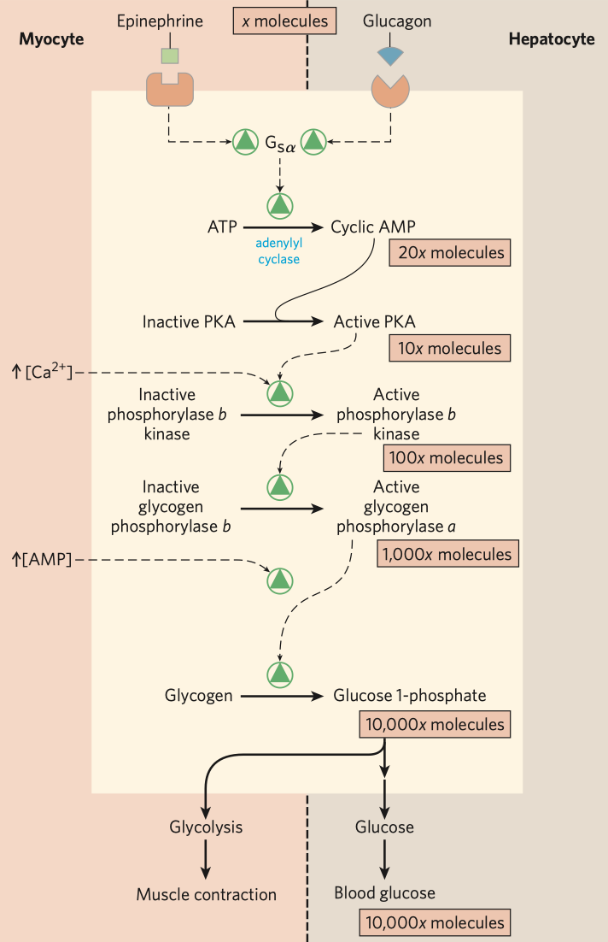
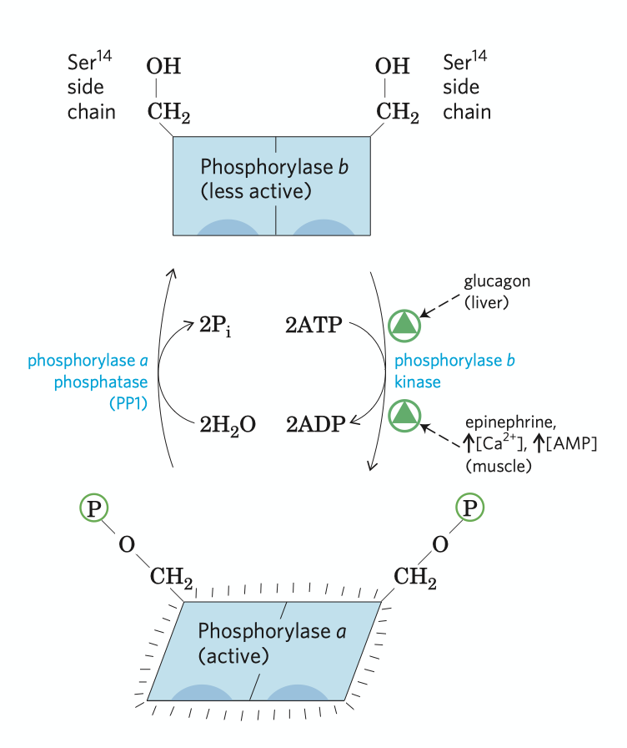
Regulation of muscle glycogen phosphorylase
Glycogen phosphorylase in skeleten muscle exists in two forms: a form (active) and b form (less active)
Elevated cAMP level in response to stimulation by epinephrine (in muscle) or by glucagon (in liver) stimulates PKA, which then phos-phorylates and activates phosphorylase b kinase to phosphrylate phosphorylase b and activates it
When muscle returns to rest, another enzyme, phosphory-lase a phosphotase removes the phosphate group in the phosphorylase a molecule and converts it to the b form, which is less active
The machenism shown left is called enzyme cascade
Notes:
Return:p2

Slide 5
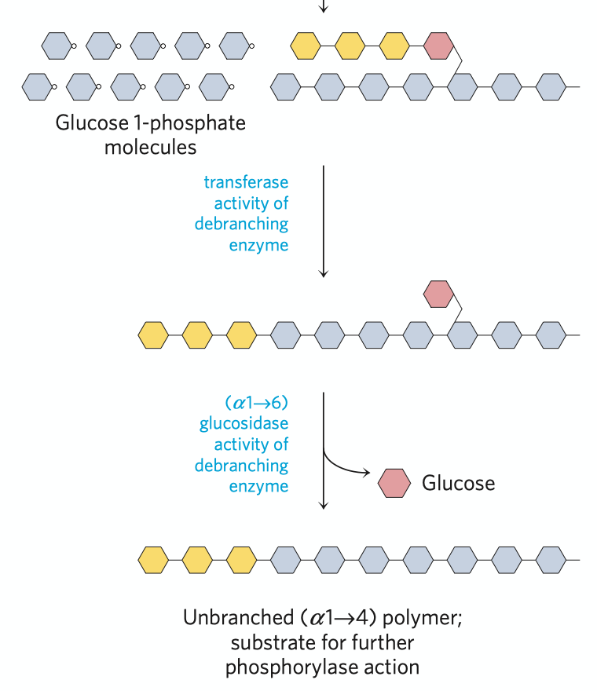
Function of debranching enzyme
Debranching enzyme
two acticities both essential to glycogen breakdown
Tranferase activity
Glycogen phosphorylase stops functioning when reaching a point four residues away from a branching point, then the debranching enzyme shifts a block of three residues from the branch to a nearby non-reducing ends by ɑ1-4 linkage.
Glycosidase activity
After removing the three residues, the enzyme still remaining at the branching point then released the single glucose residue as free glucose by hydrolysis, which attaches to the glycogen backbone by ɑ1-6 linkage.
Notes:
Return:p2

Slide 6
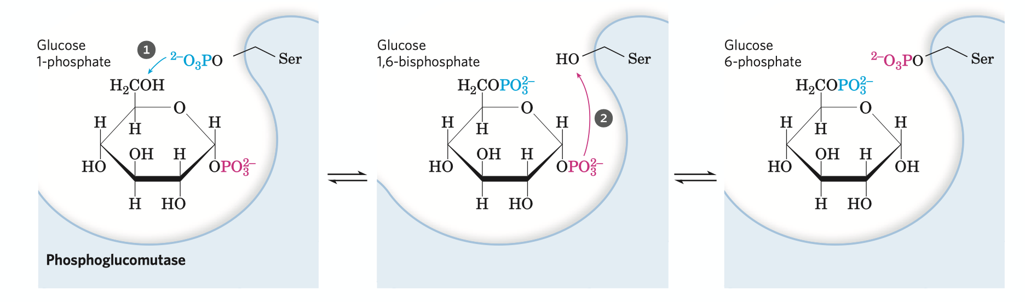
Catalyzing mechanism of phosphoglucomutase
In order to enter the glycolysis pathway, glucose-1-phosphate needs to be converted to glucose-6-phosphate, which is catalyzed by phosphoglucomutase.
The enzyme donates a phosphate group at a Ser residue to C-6 of the substrate, forming a intermediate, glucose-1,6-bisphosphate.
The enzyme then receive the phosphate group at C-1 of the glucose, reforming the phosphoenzyme.
Notes:
Return:p2

Slide 7
Glucose-6-phosphatase
Why glycogen stored in skeletal muscle can not replenish blood glucose?
Glycogen stored in skeletal muscle and liver serves different purposes. The former serves as energy source only for muscle contraction, while the latter is aimed to regulate the blood glucose level while it drops.
As a result, only in liver cells glucose-6-phosphatase occurs and can glycogen replenish blood glucose.
Why in endoplasmic reticulum membrane?
Glucose-6-phosphatase is an integral membrane protein of the endoplasmic reticulum membrane. Having its hydrolase activity at the lumenal surface, the reaction is positioned inside ER, separated from its coordinated reaction in glycolysis, which efficiently avoids futile cycle.
Related metabolism deficiency
Carrying such important function, genetic defects of this enzyme can cause serious metabolism deficiency, such as type Ia glycogen sotrage disease.
Notes:
Return:p2

Slide 8
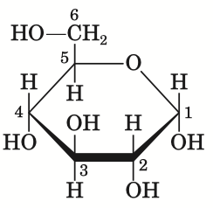
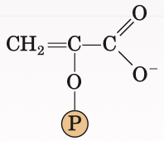
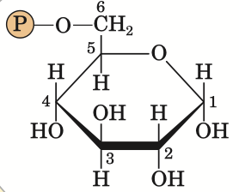
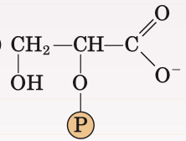
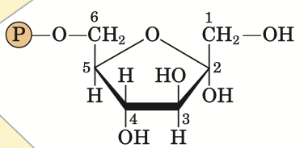
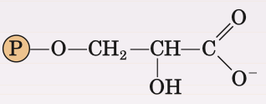
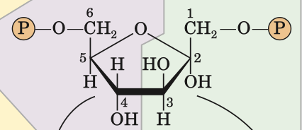
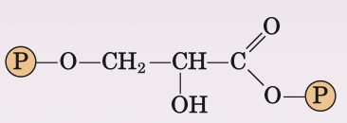


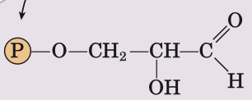

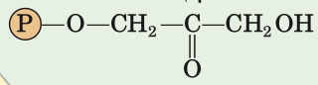
Glycolysis
pyruvate
glucose
ATP
ATP
pyruvate kinase
hexokinase
ADP
preparatory phase
ADP
phosphoenolpyruvate
payoff phase
glucose-6-phosphate
enolase
phosphohexose
isomerase
2-phosphoglycerate
phosphoglycerate
mutase
fructose-6-phosphate
3-phosphoglycerate
ATP
phospho
-fructokinase-1
phosphoglycerate
kinase
ATP
ADP
ADP
froctose-1,6-biphosphate
1,3-bisphosphoglycerate
NADH H+
aldolase
glyceraldehyde 3-phsophate
dehydrogenase
NAD+
glyceraledehyde 3-phosphate
dihydroxyacetone phosphate
triose phosphate isomerase
some important figures
Notes:
Hexokinase:p9
Phospho-fructokinase-1:p10
Aldolase & triose~:p11
Pyruvate kinase:p12
Some important figures:p14
Preparatory phase:p15
Payoff phase:p16
Return:p1

Slide 9
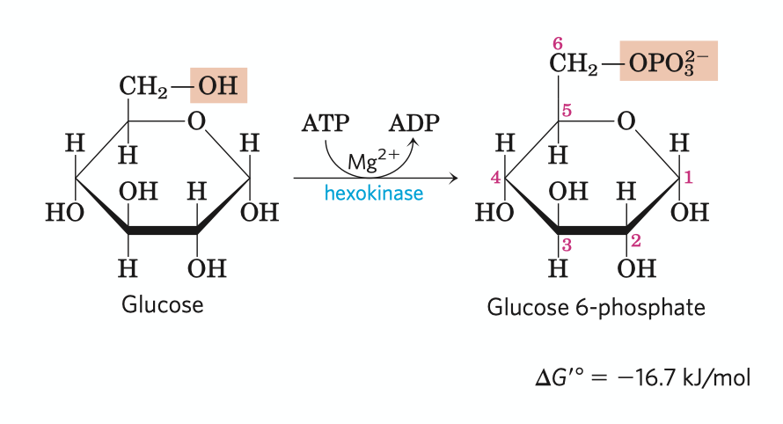
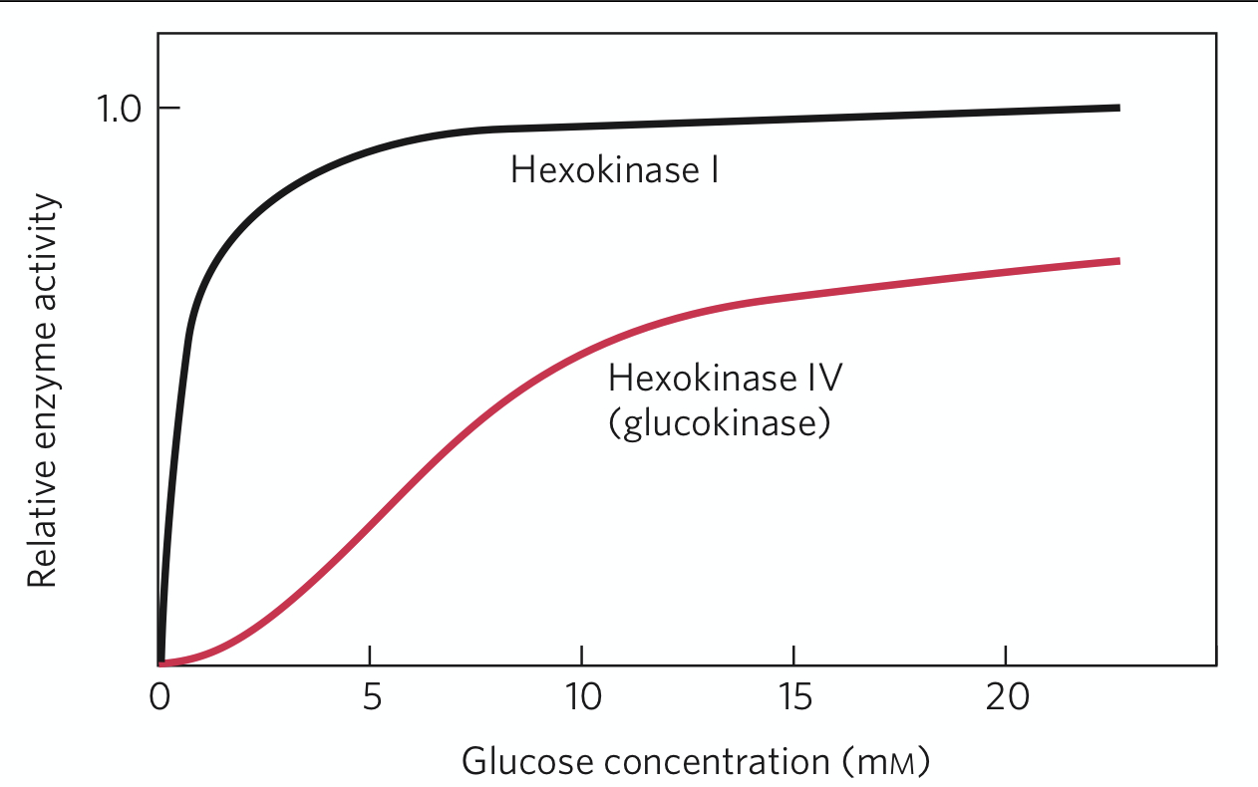
Phosphorylation of glucose
Irreversible
The reaction consumes an ATP
Requires Mg2+ for the kinase's activity (using MgATP2- but not ATP4- as substrate)
Hexokinase has four isozymes, among which the fourth one in hepatocytes (glucokinase) has many unique characteristics, such as extremely high Km and resistence to G-6-P inhibition
Notes:
Return:p8

Slide 10


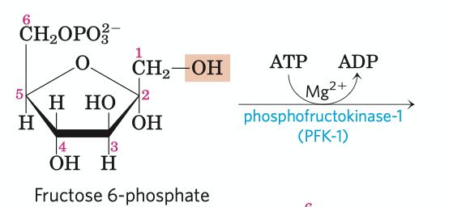
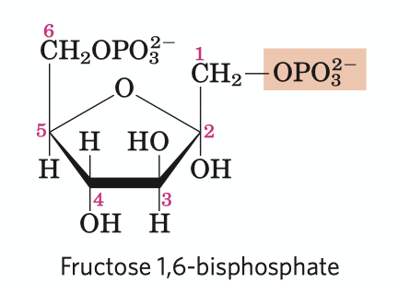
Phosphorylation of fructose phosphate
irreversible (key site for regulation)
the first “commited” reaction in the glycolytic pathway former chemicals has other fates, but 1,6-FBP is targeted for glycolysis
some bacteria and protists, perhaps all plants use bisphosphate instead of ATP as the phosphoryl group donor
PFK-1 undergoes complex allosteric regulation
ADP
AMP
fructose-2,6-bisphosphate
ATP
Ribulose-5-phosphate
Notes:
Return:p8

Slide 11
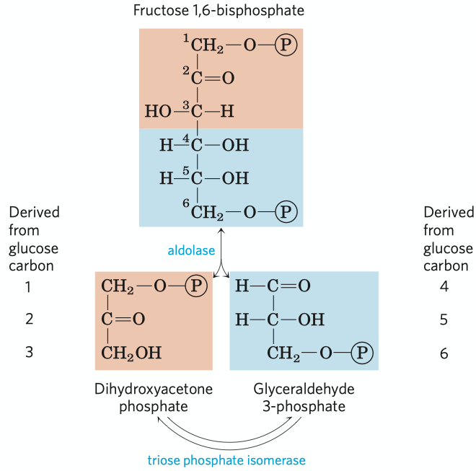
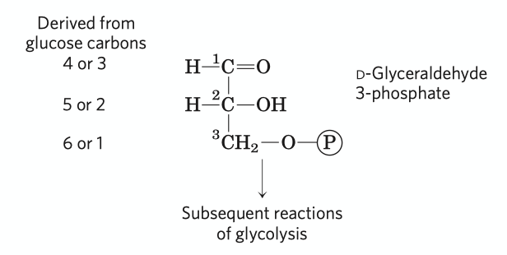
Fate of the glucose carbons
Just remember the phosphorylated carbons (C-1 and C-6 in hexose) remain phosphorylated in the triose (C-3)
After the triose isomerase reaction, the carbon atoms derived from C-1, C-2 and C-3 of the starting glucose cannot be chemically distinguished from the C-6, C-5 and C-4, coordinatedly.
Notes:
Return:p8

Slide 12
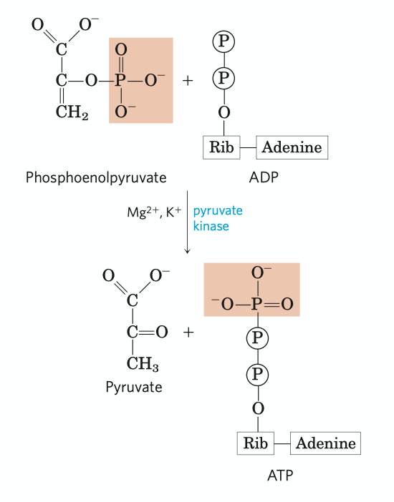
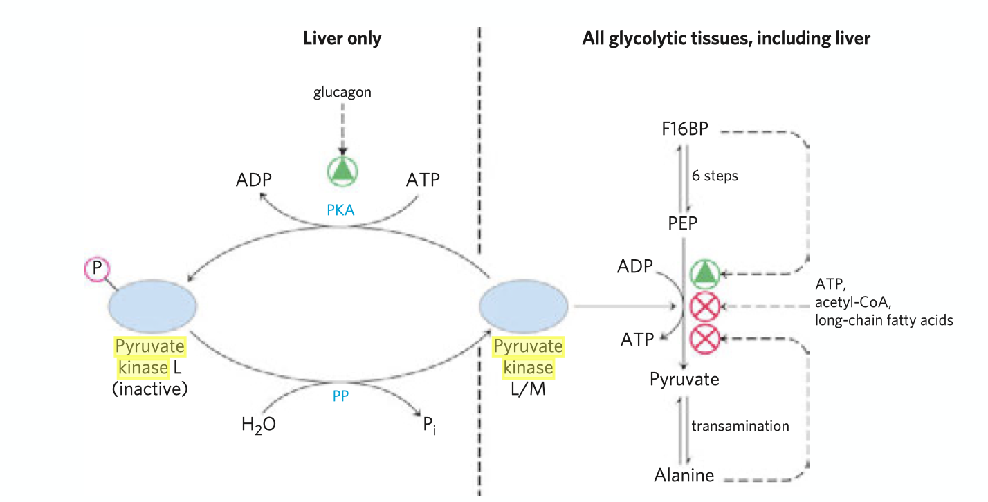
Pyruvate kinase
Irreversible
Pyruvate kinase requires K+ and either Mg2+ or Mn2+
The product pyruvate first appears in its enol form, then tautomerizes rapidly and nonenzymeticly to its keto form, which predominates at neutral pH
Pyruvate kinase is under tight regulation
High concentrations of ATP, acetyl-CoA and long-chain fatty acids can allosterically inhibit all isozymes
The liver isozyme is subject to phos-phorylation regulation, which occurs when glucagon is excreted
Notes:
Return:p8

Slide 13
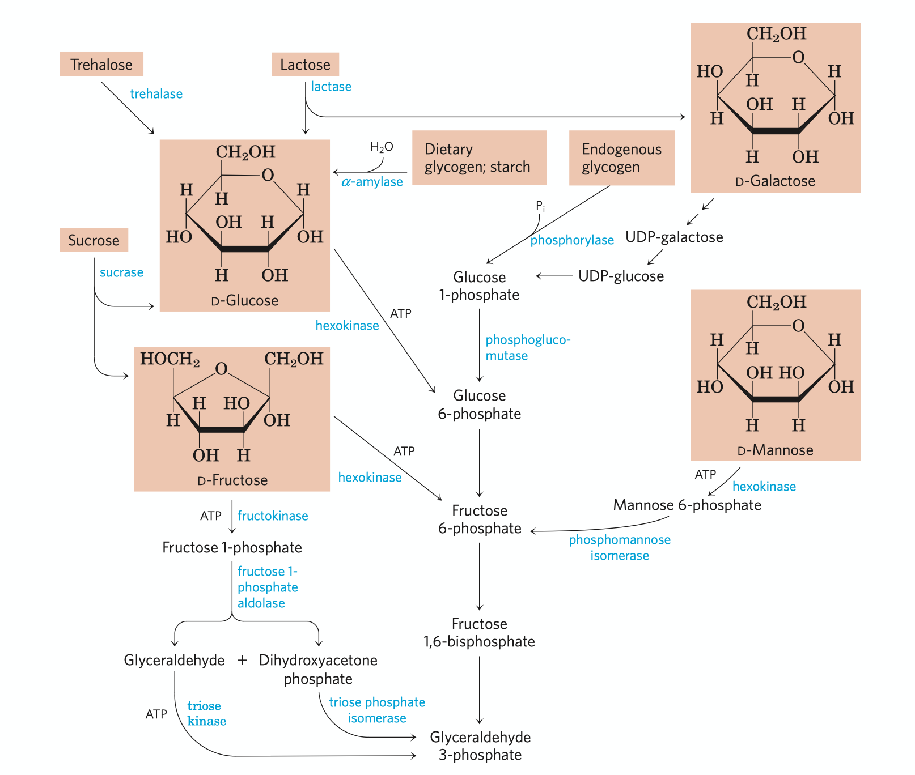
Entry of some other carbohydrates
Notes:
Return:p8

Slide 14
Some important figures of glycolysis
pyruvate
pyruvate
pyruvate
glucose
glucose
glucose
ATP
ATP
ATP
ATP
ADP
ADP
ADP
ADP
phosphoenolpyruvate
net energy change:
- 2ATP + 4ATP + 2NADH
(1NADH = 2.5 ATP)
= 7ATP/Glucose
phosphoenolpyruvate
phosphoenolpyruvate
glucose-6-phosphate
glucose-6-phosphate
glucose-6-phosphate
2-phosphoglycerate
2-phosphoglycerate
2-phosphoglycerate
fructose-6-phosphate
fructose-6-phosphate
fructose-6-phosphate
3-phosphoglycerate
ATP
3-phosphoglycerate
3-phosphoglycerate
ATP
ATP
ATP
ADP
ADP
ADP
ADP
froctose-1,6-biphosphate
froctose-1,6-biphosphate
froctose-1,6-biphosphate
1,3-bisphosphoglycerate
1,3-bisphosphoglycerate
1,3-bisphosphoglycerate
NADH H+
NADH H+
NADH H+
NAD+
NAD+
NAD+
glyceraledehyde 3-phosphate
dihydroxyacetone phosphate
glyceraledehyde 3-phosphate
glyceraledehyde 3-phosphate
Notes:
Return:p8

Slide 15
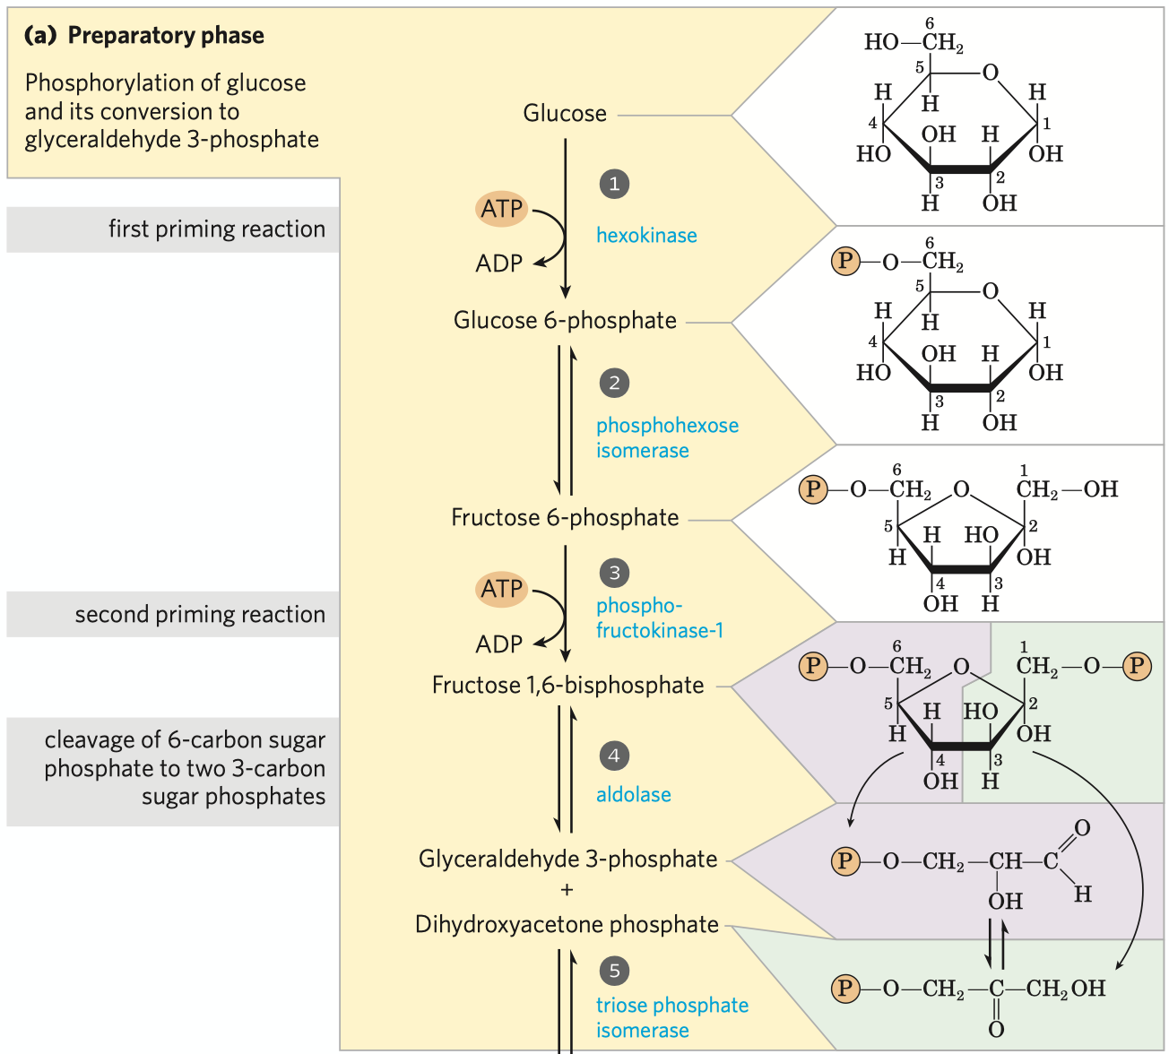
Preparatory phase
Two priming reactions in this phase, phosphorylation of glucose and phosphory-lation of F-6-P, each consumes an ATP.
In the preparatory phase of glycolysis, two ATPs are required for stimulation. No substrate level phosphorylation, no oxidative phosphorylation.
The hexose is finally hydrolyzed to two triose, glyceraldehyde 3-phosphate and dihydroxy-acetone phosphate after four steps.
Phosphorylation can retain the intermediates in cell, conserve energy in the formation of phosphate esters and activates the reactions by providing binding energy between phosphate groups and certain sites in the enzyme.
Notes:
Return:p8

Slide 16
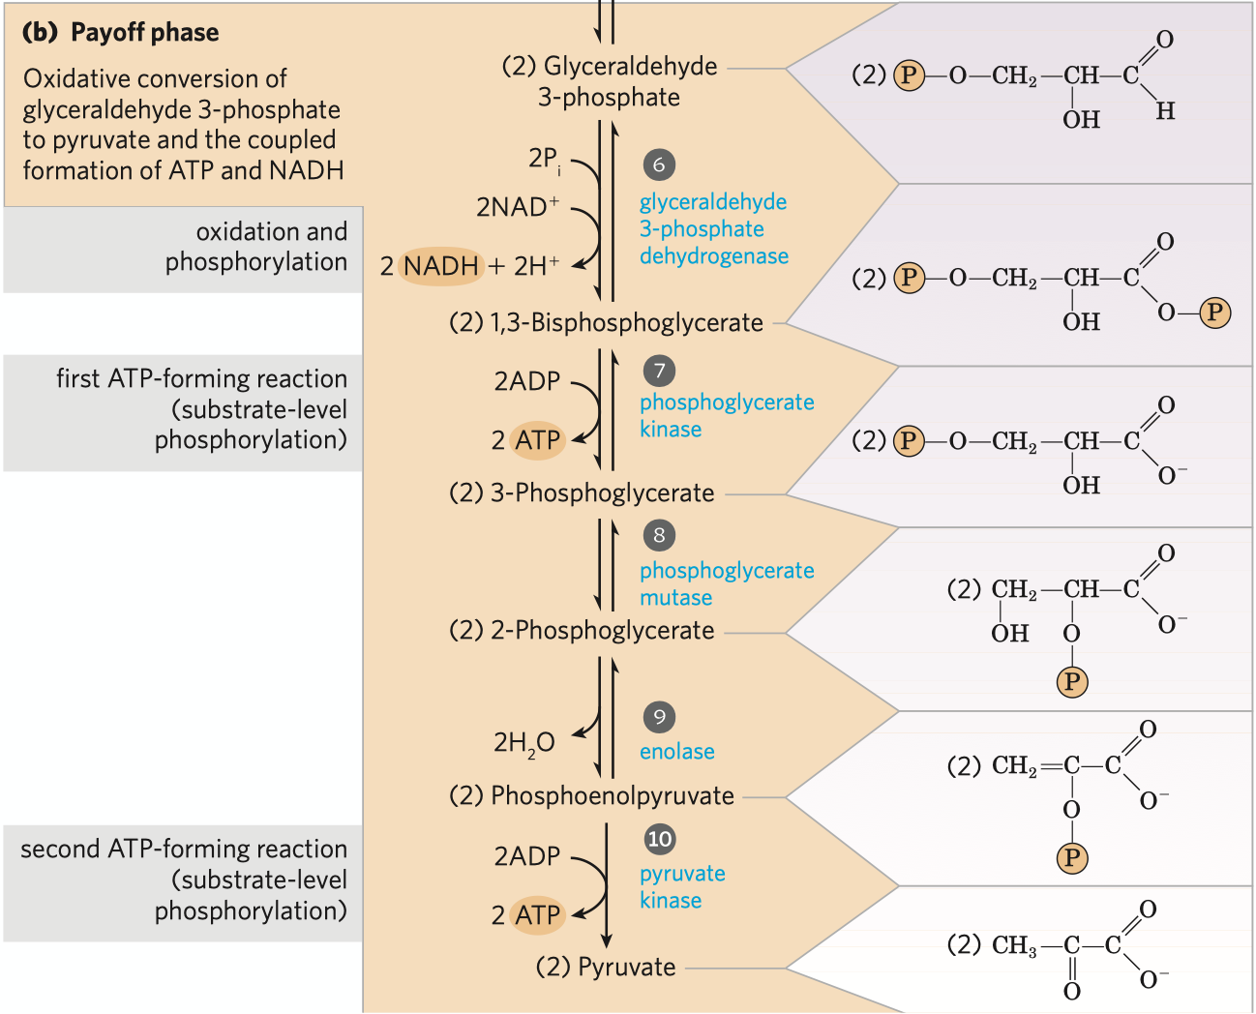
Payoff phase
Remember that one glucose has been converted to two glyceraldehyde-3-phosphate in the preparatory phase.
Each phospho-triose generates 2ATP and 1 NADH through two substrate level phosphorylation reactions and one dehydrogenation reaction.
Notes:
Return:p8

Slide 17



NADH
pyruvate dehydrogenase complex
Acetyl-CoA
NAD+
pyruvate
oxaloacetate
citrate synthase
malate dehydrogenase
citrate
malate
aconitase
fumarase
Citric acid cycle
isocitrate
fumarate
NAD+
isocitrate dehydrogenase
succinate dehydrogenase
NADH
FADH2
ɑ-ketoglutarate dehydrogenase complex
ɑ-ketoglutarate
CO2
succinyl-CoA
synthetase
succinate
FAD+
succinyl-CoA
GTP(ATP)
NAD+
GDP(ADP)
CO2
NADH
Notes:
pyruvate dehydrogenase complex:p18
Citrate synthase:p20
Isocitrate dehydrogenase:p21
a-ketoglutarate dehydrogenase complex:p22
Succinyl-CoA synthetase:p24
Succinate dehydrogenase:p25
Malate dehydrogenase:p26
Citric acid cycle:p27
Return:p1

Slide 18
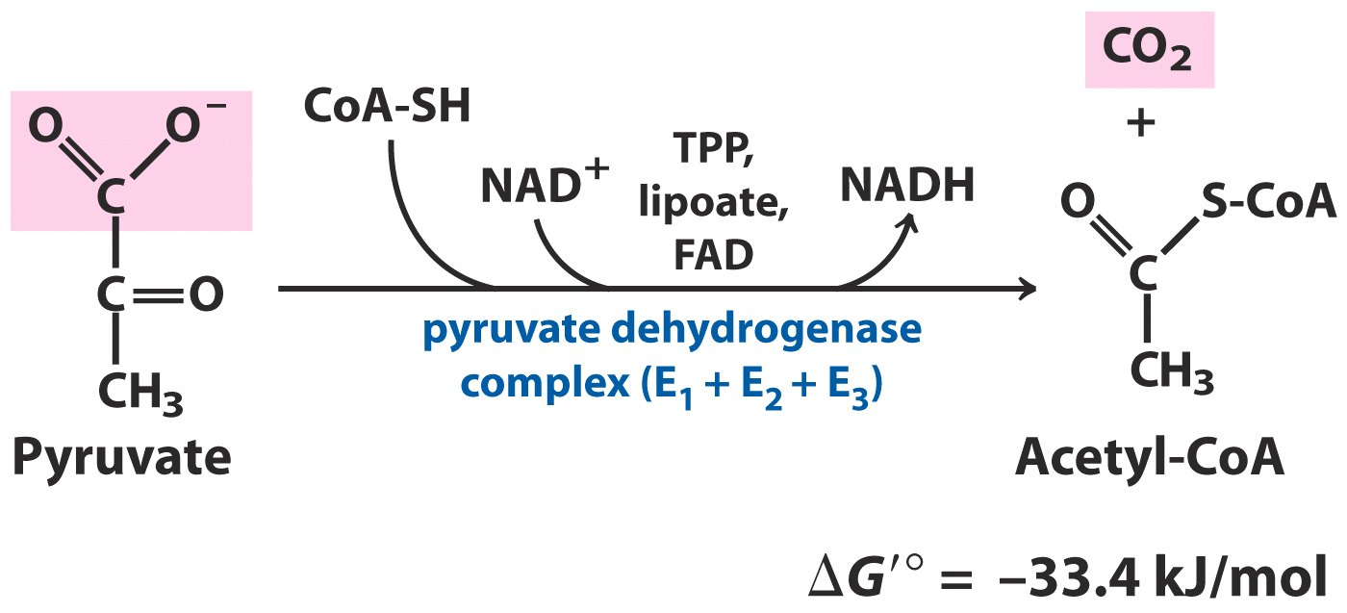
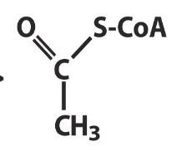
Decarboxylation of pyruvate
CoA-SH
acetyl carrier
NAD+
proton and electron carrier
proton and electron carrier
FAD
mechanism
proton and electron carrier
cofactors
proton and electron carrier
cofactors
cofactors
three enzymes:
E1 pyruvate dehydrogenase
E2 dihydrolipoyl transacetylase
E3 dihydrolipoyl dehydrogenase
TPP
carry hydroxyethyl group
carry hydroxyethyl group
lipoate
serves both as an electron
carrier and an acyl carrier
serves both as an electron
carrier and an acyl carrier
Acetyl-CoA is the central intermediate of catabolism, not only carbohydrate but also amino acids and fatty acids are first degraded to acetyl group of acetyl-CoA and then enter the ctric acid cycle for further degradation.
Notes:
Mechanism:p19
Return:p17

Slide 19
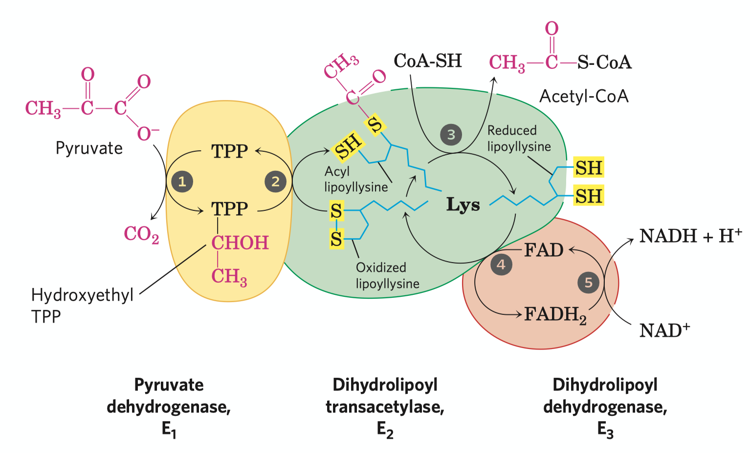
Mechanism of pyruvate decarboxylation
All the enzymes and coenzymes are clustered, allowing the intermediates to react quickly without diffusing away.
This mechnism is called substrate channeling
Notes:
Return:p17

Slide 20
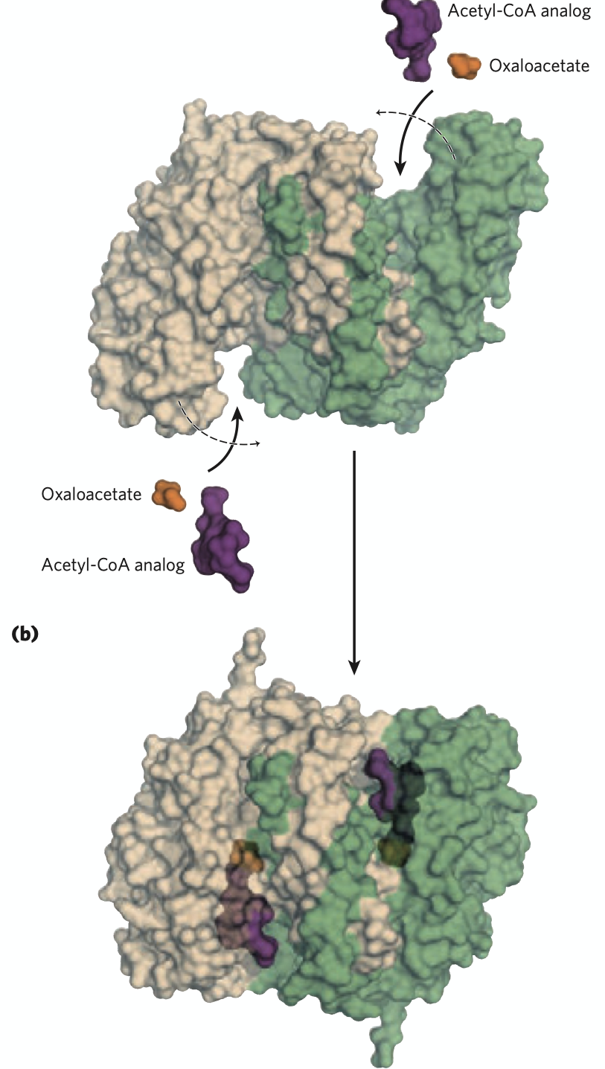
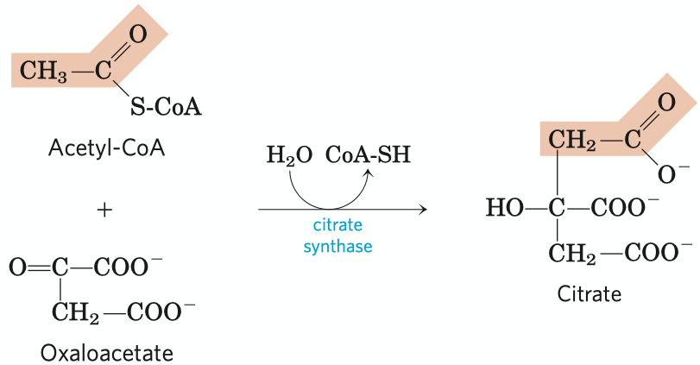
Formation of citrate
Irreversible (the first regulation site in citric acid cycle)
2C+4C=6C. The methyl carbon of the acetyl-CoA is joint to the carbonyl carbon(C-2) of the oxaloacetate. In other words, C1 and C2 of the newly formed citrate molecule is from acetyl-CoA.
The large free energy change is essential to the reaction, as [oxaloacetate] is really low.
Catalyzing mechanism: oxaloacetate binds to the enzyme first, creating a binding site for acetyl-CoA.
Notes:
Return:p17

Slide 21
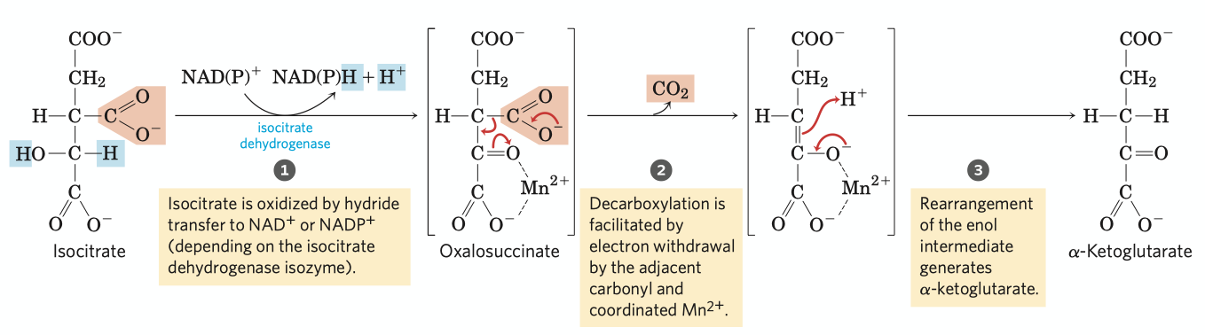
Oxidative decarboxylation of isocitrate
6C-1C = 5C.
First decarboxylation reaction in citric acid cycle, generating a NADH.
Catalyzed by isocitrate dehydrogenase, assisted by inorganic ion Mn2+.
There're two isoenzymes of isocitrate dehydrogenase in vivo, one using NAD+ as oxidative reagent, the other using NADP+.
Notes:
Return:p17

Slide 22
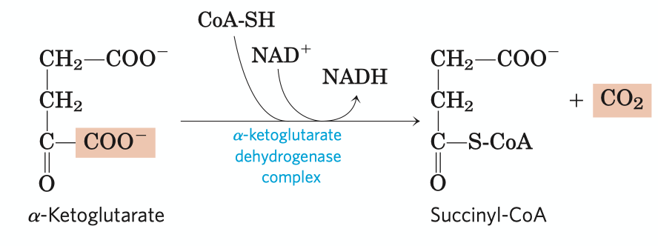
Oxidative decarboxylation of ɑ-ketoglutarate
An typical example of divergent evolution
a-ketoglutarate dehydrogenase complex
pyruvate dehydrogenase complex
branched-chain a-keto acid dehydrogenase
Irreversible
The second decarboxylation reaction of citric acid cycle, generating a NADH.
Catalyzed by a-ketoglutarate dehydrogenase complex, with NAD+ serving as electron acceptor and CoA-SH as succinyl group carrier.
Energy released from oxidation is stored in the thioester bond of succinyl group, which can be applied to the synthesis of ATP in the next reaction.
Notes:
An typical example of divergent evolution:p23
Return:p17

Slide 23
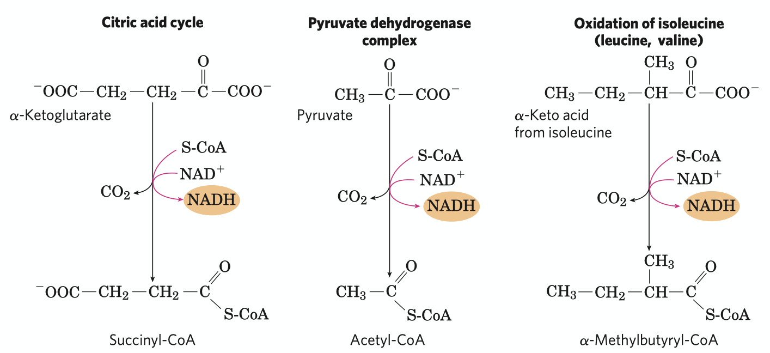
A conserved mechanism for oxidative decarboxylation
Three homologous enzymes
E1:
different amino sequence
different binding specificty
similar structure
E2:
similar tertiary structure
similar primary structure
E3:
identical
Similarities
Same reaction mechanism.
The cofactors needed are identical: TPP, lipoate, CoA-SH, NAD+ and FAD.
The three enzymes in the complex are respectively similar.
Notes:
Return:p22

Slide 24
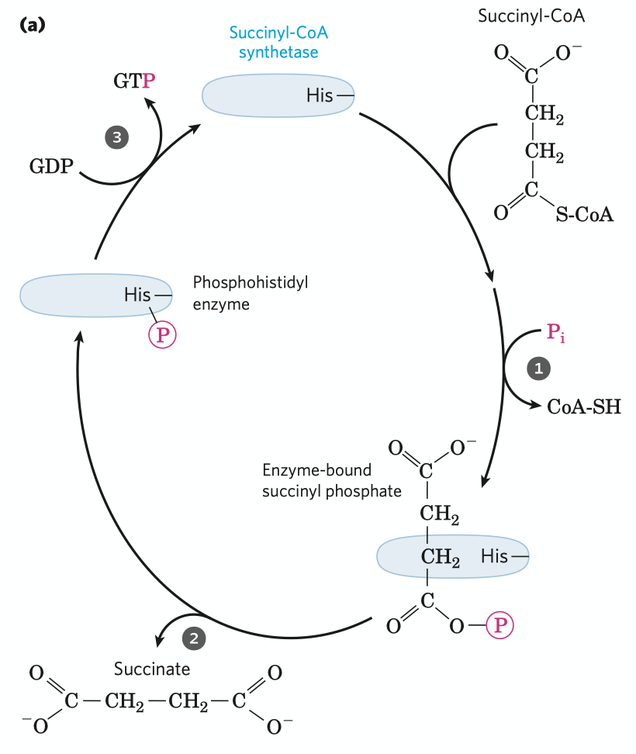
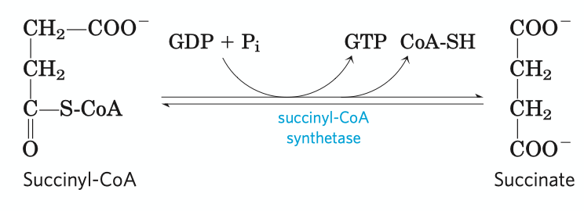
Conversion of succinyl-CoA to succinate
A reversible substrate level phosphorylation reaction, the energy for ATP synthesis comes from the thioester bond in succinyl-CoA.
There're two isozymes of succinyl-CoA in vivo, one using GDP as substrate, another using ADP. As GTP can directly transfer its phosphate group to ADP, the net result of activities of each enzymes is the conservation of energy as ATP.
This reaction involves a phosphoenzyme intermediate.
Notes:
Return:p17

Slide 25

Oxidation of succinate
A reversible oxidation reaction, generating a FADH2 per succinate molecule, which energatically equals to 1.5 ATP in respiration-linked phosphorylation.
Catalyzed by succinate dehydrogenase, which is tightly bound to the mitochondrial inner membrane (plasma membrane in bacteria) as a member of the complex II in the electron transfer chain.
Can be inhibited by malonate, a strong competitive inhitor, also an analog of succinate.
Notes:
Return:p17

Slide 26

Oxidation of malate
The last step of citric acid cycle, catalyzed by malate dehydrogenase.
An irreversible oxidative reaction, generating a NADH.
Equilibrium of the reaction lies far to the left, but the continue removal of oxaloacetate drives the reaction to the right.
Notes:
Return:p17

Slide 27

Product of one turn of TCA cycle
One turn of cycle includes:
Two steps of decarboxylation (3rd and 4th)
Four steps of oxidation (3rd, 4th, 6th and 8th)
One step of substrate level oxidation
STEP | REDUCING COENZYME | ATP (GTP)
pyruvate acetyl-CoA | 1NADH
isocitrate a-ketoglutarate | 1NADH
a-ketoglutarate succinyl-CoA | 1NADH
succinyl-CoA succinate |  | 1A/GTP
succinate fumarate | 1FADH2
malate oxaloacetate | 1NADH
TOTAL | 4NADH + 1FADH2
Notes:
Return:p17

Slide 28


Fermentation
Under anaerobic condition, NADH generated from glycolysis maybe unable to be oxidized through the electron transfer chain. The lack of NAD+ would block the pathway, so our body passes the electrons to glycolysis products to regenerate NAD+. In such way, there're no net change of NAD+ number while two ATPs are generated through glycolysis.
Lactic fermentation exists in animals.
Ethanol fermentation exists in plants, yeasts and some other microorganisms.
Notes:
Lactic fermentation exists in animals:p29
Ethanol fermentation~:p30
Return:p1

Slide 29

Lactate fermentation
Reversible.
Usually in animal tissues, the electrons are directly passed to pyruvate and lactates are generated as the reducing products under anaerobic conditions.
Some tissues and cell types (such as erythrocytes, which has no mitochondria and thus cannot oxidize NADH) produce lactates even under aerobic conditions.
Lactate dehydrogenase has two forms, L form and M form. In most tissues like skeleton muscle and erythrocytes, the enzyme is in M form, catalyzing the reaction to the right. Generated lactates in this tissues can be carried through blood to liver, where the enzyme is in its L form and accelarates the reverse reaction to oxidize the lactates.
Notes:
Return:p28

Slide 30

Ethanol fermentation
Ethanol fermentation includes two reactions, a decarboxylation step and a reduction reaction.
The first step is a simple decarboxylation involcing no net oxidation of pyruvate catalyzed by pyruvate decarboxylase, generating acetaldehyde as well as releases a CO2. The enzyme is absent in vertebrate tissues and the organisms that carry lactate fermentation.
In the second step, the electrons of NADH is transferred to acetaldehyde to generate ethanol, catalyzed by alcohol dehydrogenase, which also exists in many organisms which do not carry ethanol fermentation but metabolize ethnol. However, in this organisms the reaction proceeds to the left.
Notes:
Return:p28

Slide 31

Pentose phosphate pathway
Nonoxidative phase
Oxidative phase
Pentose phosphate pathway is a fate of glucose-6-phosphate which gyields specialized products needed for cell growth.
Rapidly dividing cells, such as thosu of bone marrow, skin, and intestinal mucosa, and those of tumors, use pentose 5-phosphate to make RNA, DNA and coenzymes such as ATP, NADH.
NADPH generated in this pathway is needed for some other tissues for reductive biosynthesis or to counter the damaging effects of oxygen radicals.
There're two different types of pentose occurring in nature, the oxidative one and the reductive one, the former exists in most animal tissues and the latter occurs in plant tissues and is crucial to the photosynthetic assimilation of CO2.
Oxidative pentose phosphate pathway is divided into oxidative phase and nonoxidative phase .
Notes:
Nonoxidative phase:p32
Oxidative phase:p33

Slide 32


Oxidative phase
reaction equation of the oxidative phase
lactose
Mg2+
The net result of the oxidative phase is the production of NADPH, a reductant for biosynthetic reactions, and ribose 5-phosphate, a precursor for nucleotide synthesis.
Notes:
Return:p31

Slide 33

Nonoxidative phase
In the rapidly dividing cells, ribulose is further converted to ribose for nucleic acid synthesis. In tissues that primarily needs NADPH, the pentose would go into the nonoxidative phase and is converted to six-carbon sugar phosphates after a series of rearrangements of the carbon skeletons.
Many different sugar of different carbon numbers is generated in this phase.
Notes:
Return:p31

